Slide 1
AI module

Slide 2
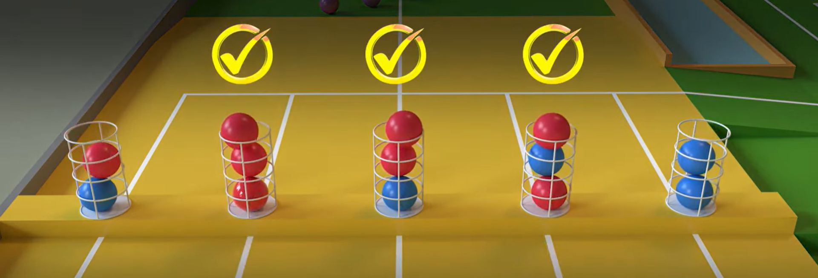
Goal State:
“Mùa Vàng”

Slide 3
Monte Carlo Tree Search (MCTS):
Monte Carlo Tree Search (MCTS) is a method for making optimal decisions in artificial intelligence (AI) problems, typically move planning in combinatorial games.
A search tree is built, node by node, according to the outcomes of simulated playouts. The process can be broken down into the following steps:
Selection
Expansion
Simulation
Back Propogation

Slide 4
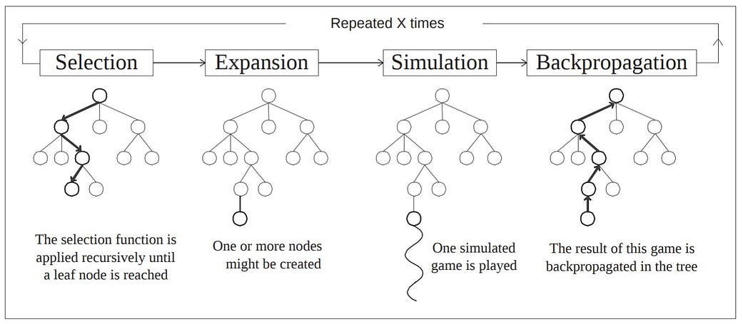
Basic Algorithm

Slide 5
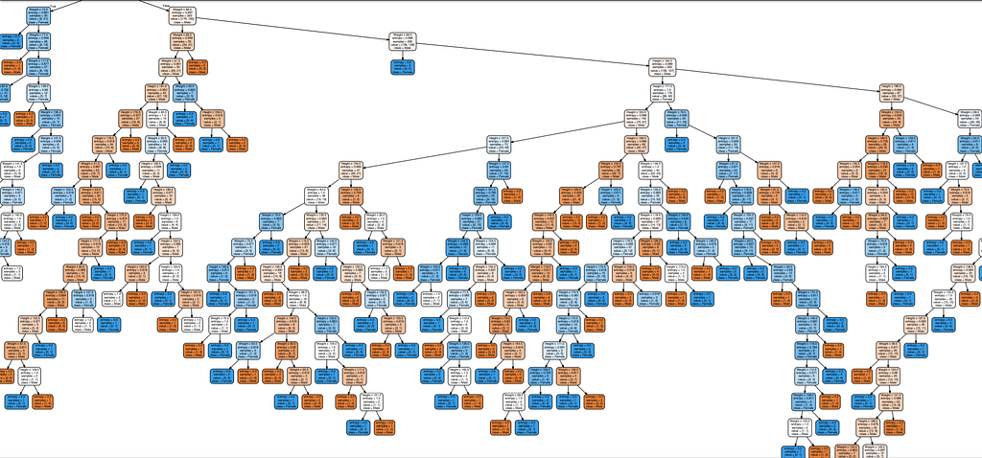
Problem of Decision Tree?

Slide 6
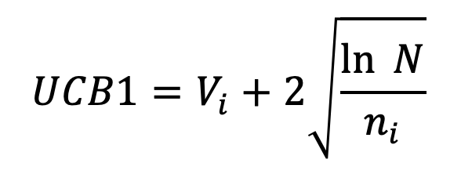
UCB Value (Upper Confident Bound)
Chooses which node to visit next based on the equation
where,
Vi is the average reward/value of all nodes beneath this node
N is the number of times the parent node has been visited, and
ni is the number of times the child node i has been visited

Slide 7
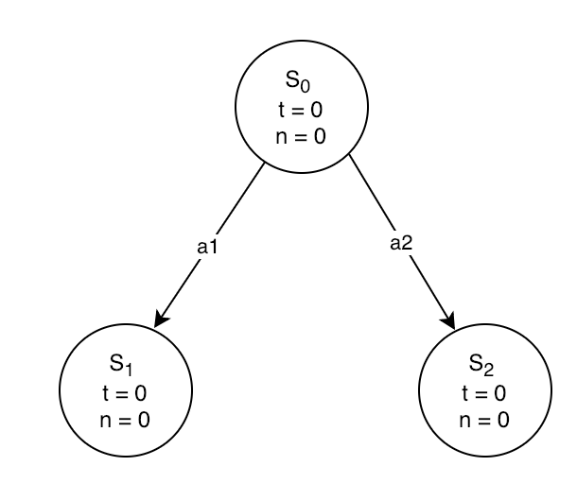
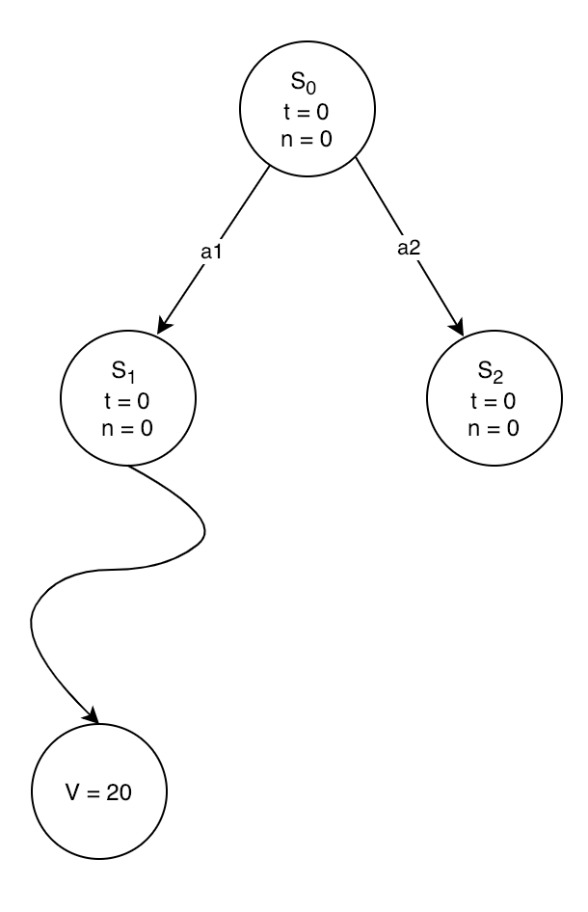
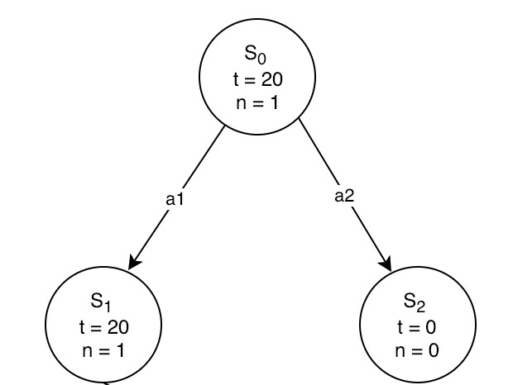
Iteration 1:
Initial State
Post Backpropogation
Rollout from S1

Slide 8
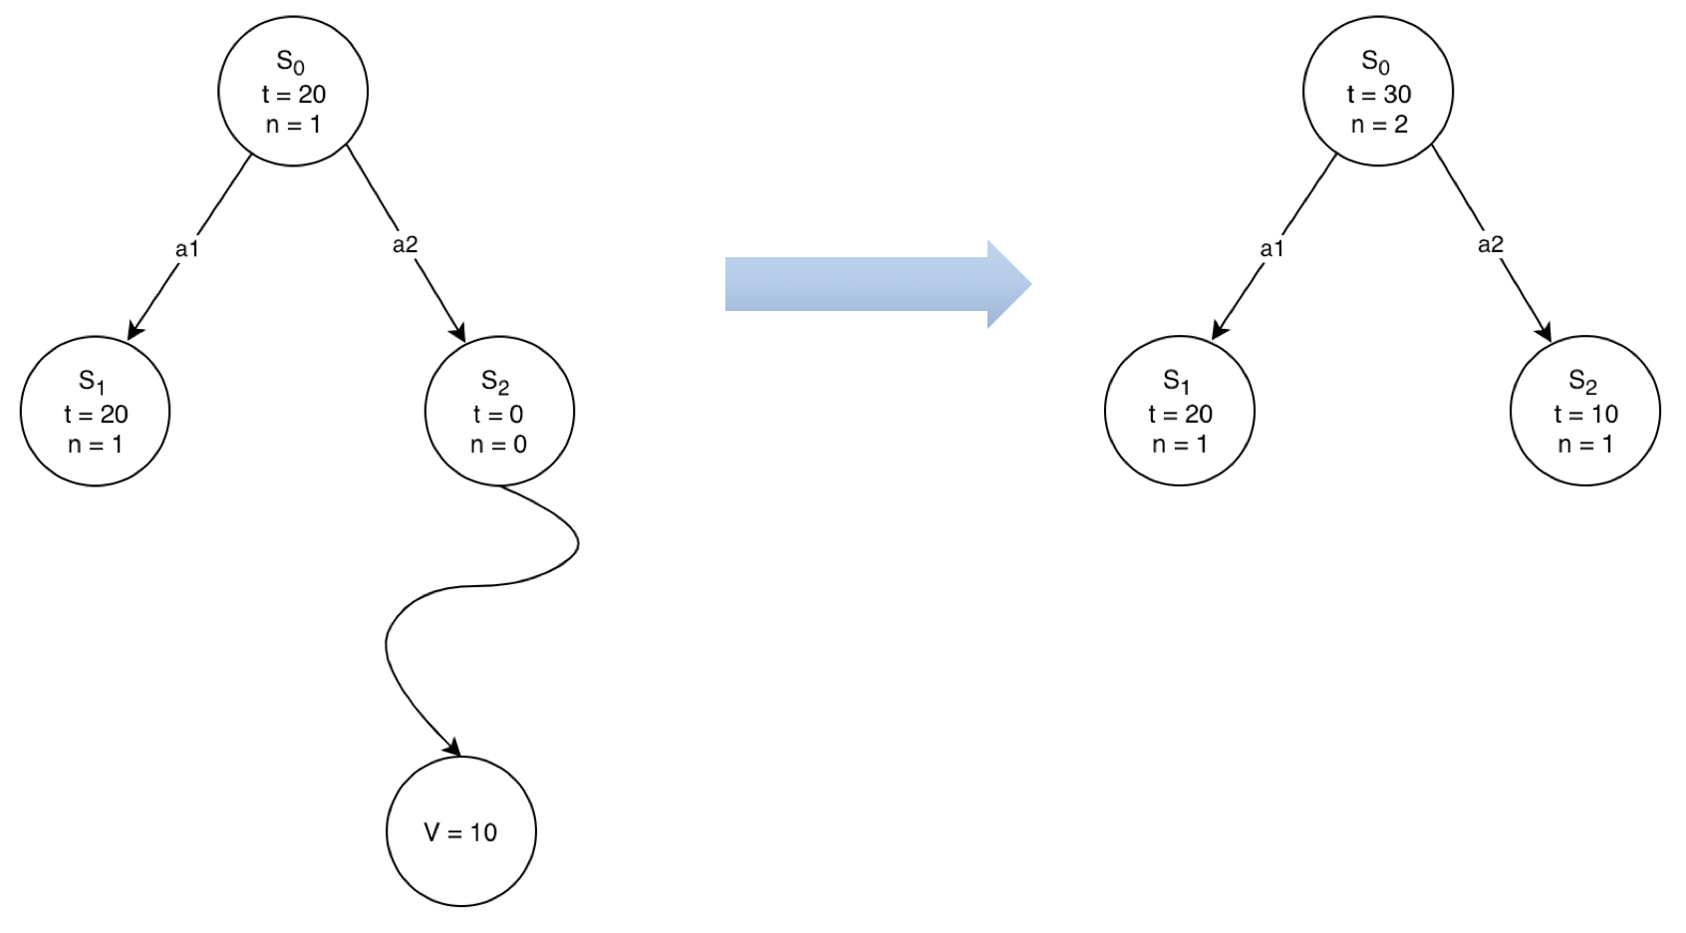
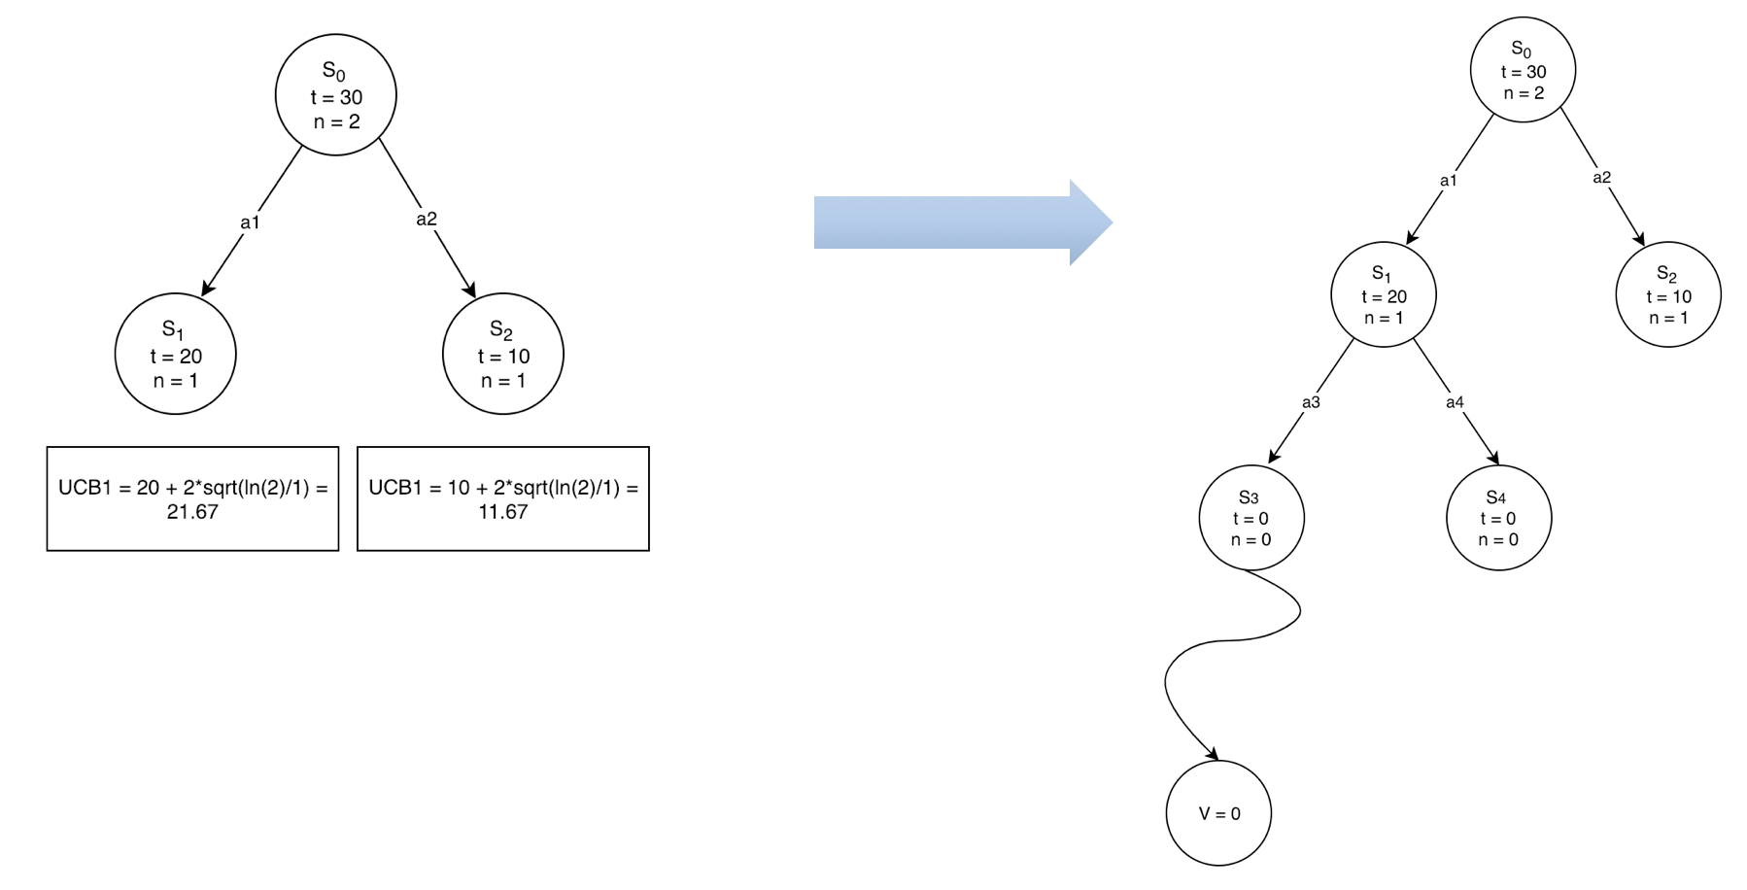
Iteration 2 & 3:
Backpropogation from S2
S1 has a higher UCB1, so repeat:

Slide 9
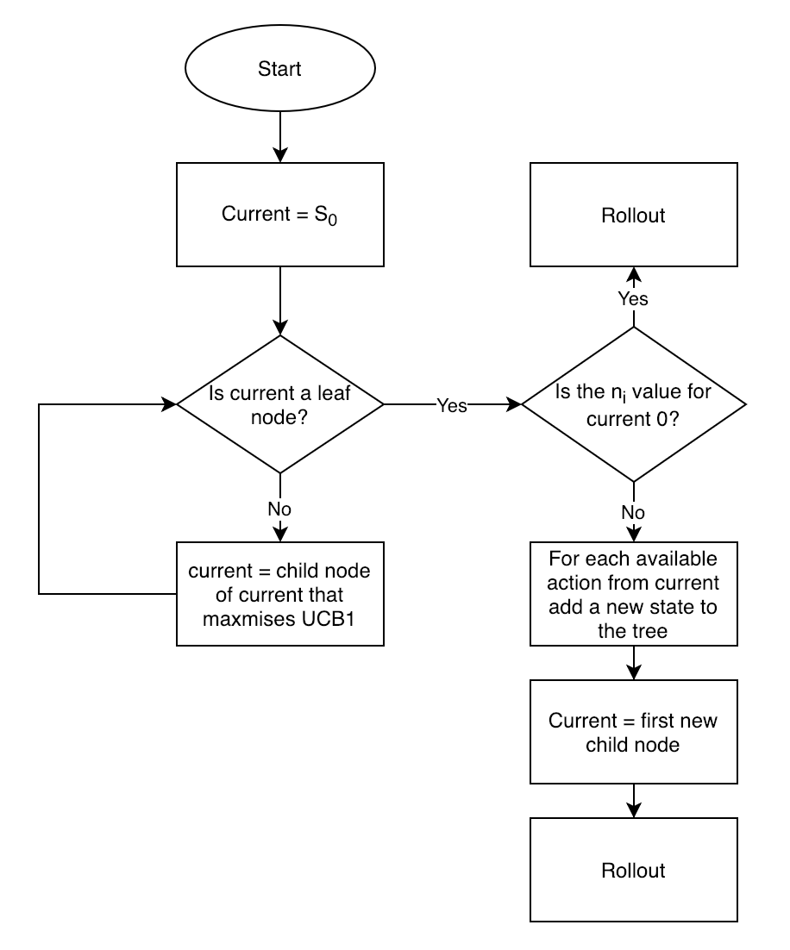
Rollout
Until we reach the leaf node, we randomly choose an action at each step and simulate this action to receive an average reward when the game is over.
Loop Forever:
if Si is a terminal state:
return Value(Si)
Ai = random(available_actions(Si))
Si = Simulate(Si, Ai)
This loop will run forever until you reach a terminal state.

Slide 10
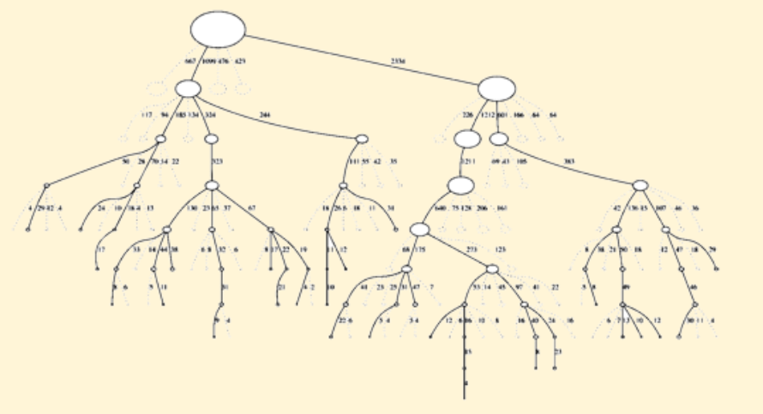
Benefits:
Asymmetric: only focusses its search time in more relevant parts of the tree.

Slide 11
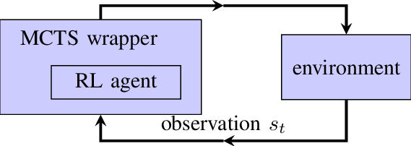
Reinforcement Learning (RL):
Can be combined with Monte Carlo Tree Search (MCTS) to enhance its decision-making capabilities in complex environments.
Integrating RL with MCTS can be computationally expensive, so it's important to strike a balance between exploration and exploitation.
Exploration: choosing actions that may be suboptimal but need further exploration
Exploitation: choosing actions that are known to be good (balance these aspects using methods like UCB)
Repeat and Learn: Over multiple iterations, agent will learn better strategies for choosing actions and will refine its decision-making process

